Slide 1

Database Management System (CS232) BS(SE,CySec) gg
Week 03
Said Nabi
said.nabi@giki.edu.pk
Faculty of Computer Science and engineering
Gik Institute Topi, Swabi

Slide 2
Topics
Database Schema VS State
Database Development Process
Designing phase / Tools Used / Data Flow Diagrams
Entity Relationship Diagram

Slide 3
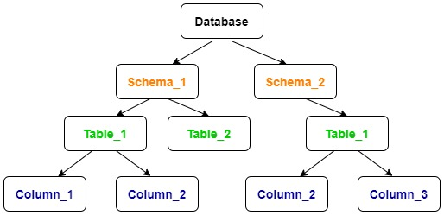
Definition of Schema
A schema is the complete design of database it is also known as intension.
It is the collection of named objects.
The names of tables, columns of each table, datatype, functions, triggers, views, packages and other objects are included in the schema.
The changes in a schema are not applied so frequently, but occasionally changes need to be applied as the requirements of application changes.

Slide 4
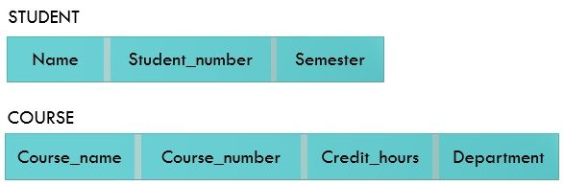
--- Example of a Database Schema

Slide 5
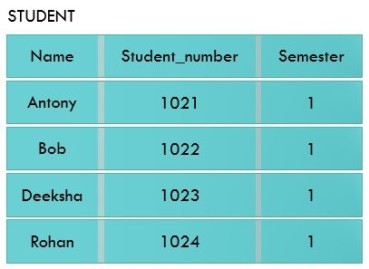
Database State
A Database state or instance is the data in the database at a particular moment of time.
Every update operation changes the database from one state to another.
The Schema is sometimes is called the intension, and the database state an extension of the schema.

Slide 6
Key Differences Between Schema and Instance
A schema is the design representation of a database whereas instance is the snapshot of a database at a particular moment.
Instance changes very frequently, whenever data is removed or added in the database. As against, the changes in schema occurs rarely.

Slide 7
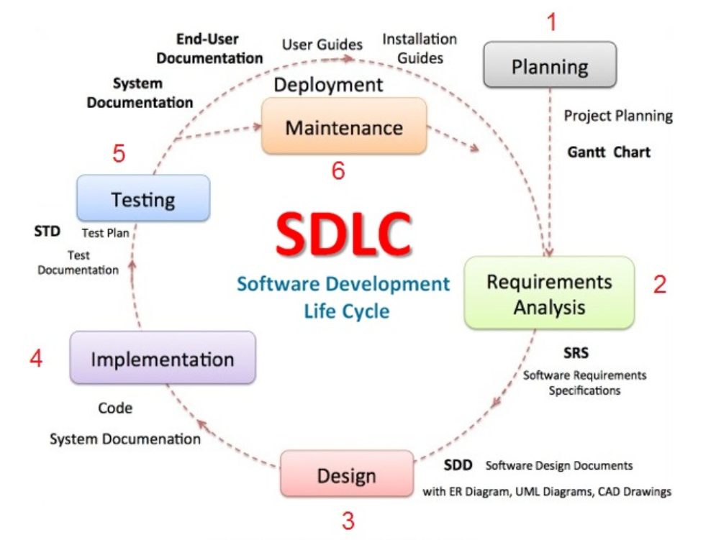
Database Development Process

Slide 8
Database Development Process Cont..
System Development Life Cycle for Database
Prelimanry Study
Similar to software development life cycles
Requirements Analysis
Database Design
Physical Design
Implentation
Maintenance

Slide 9
Staged Database Development Approach
Stages of Staged Approach (It is a type of top down approach)
Analyze User Environment
Develop conceptual model
Map conceptual model to logical Model
Choose a DBMS
Develop Physical Model
Implement system
Test system
Operational Maintenance

Slide 10
Database Development Process Cont..
Basic purpose of the database development is to satisfy the user requirements
Sometimes user interviews are also conducted to find the user needs
The two major strategies to develop database are following:
TOP DOWN
DEVELOPMENT
BOTTOM UP
DEVELOPMENT

Slide 11
Database Development Process Cont..
TOP DOWN – DEVELOPMENT
This strategies starts with general issues moving towards specific issues.
Frist of all general goals of an organization are identified.
Requirements are identified to satisfy those goals.
This model starts with specific issues moving towards general issues.
Frist of all specific goals of an organization are identified.
Requirements are identified to satisfy those goals.
BOTTOM UP – DEVELOPMEN T

Slide 12
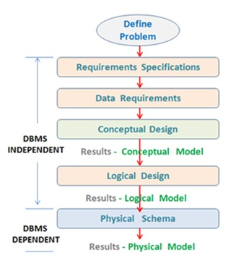
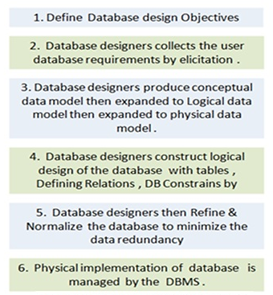
Database Development Process Cont..
System Development Life Cycle for Database

Slide 13
Data Flow Diagram
Data Flow Diagrams
Level 0 DFD
Level 1 DFD
Level 2 + DFD

Slide 14
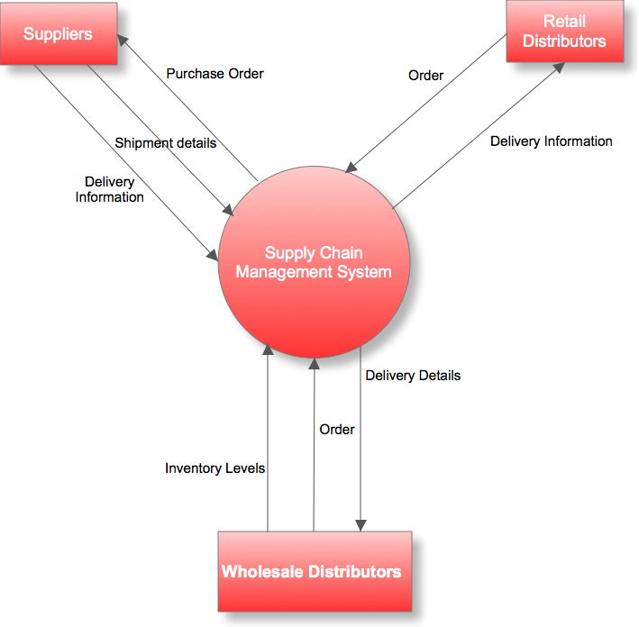
Data Flow Diagram Cont..
Level 0 DFD- Context Diagram

Slide 15
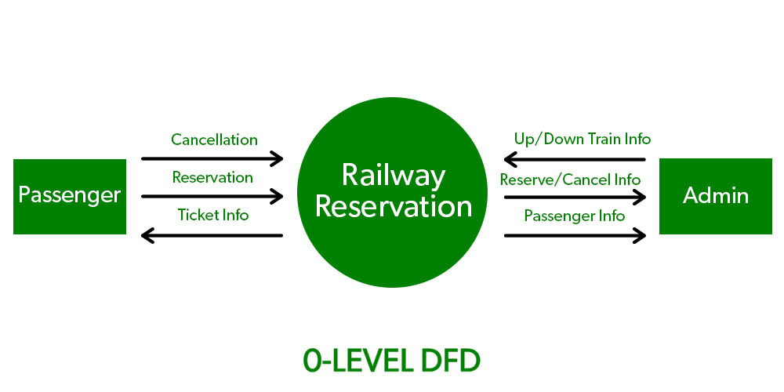
Data Flow Diagram Cont..
Level 0 DFD- Context Diagram

Slide 16
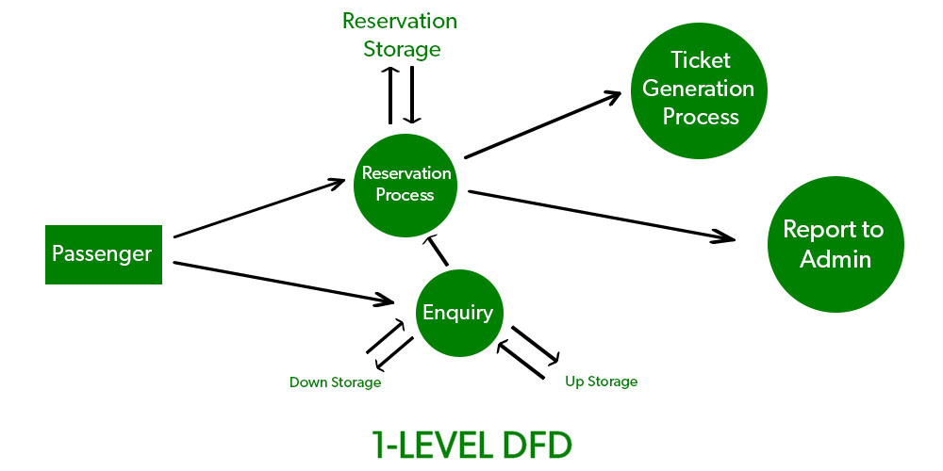
Data Flow Diagram Cont..
Level 1 DFD

Slide 17
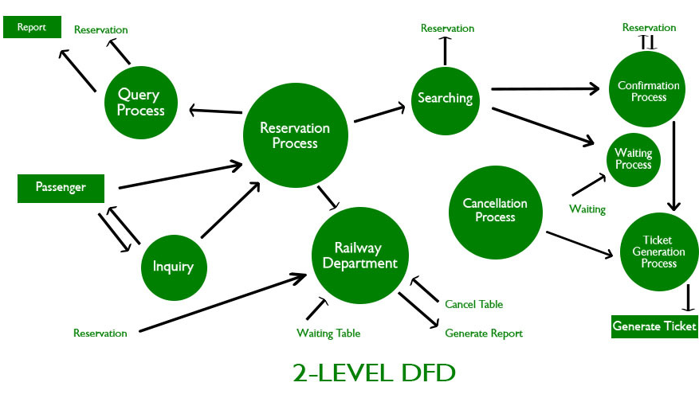
Data Flow Diagram Cont..

Slide 18
Database Administration
Database Administrator (DBA) is the main person responsible for following
Preliminary Database Planning
Writing & Maintaining Documentation
Identifying User Requirements
Developing & Enforcing Data Standards
Developing & Maintaining Data Dictionary
Developing Operating Procedures
Choosing A DBMS
Training Users
Developing Physical Model
Helping Database Users
Creating & Loading Databases
Defining Backup & Recovery Procedures
Developing User Views
Monitoring Performance
Implement Physical Model
Tuning & Reorganization

Slide 19
What is good database design?
A good database design is one that:
Divides your information into multiple tables to reduce redundant data.
Provides Access with the information it requires to join the information in the tables together as needed.
Helps support and ensure the accuracy and integrity of your information.
Accommodates your data processing and reporting needs.

Slide 20
Example:
Bad Design
O_id | C_N | C_Ad | P1_N | P1_P | P2_N | P2_P
1 | Sajid | Topi | Laptop | $1000 | Phone | $500
2 | Wajid | Swabi | Airpods | $200 | Tablet | $2000
3 | Sajid | Topi | Laptop | S1000
Good Design
P_id | P_N | P_P
1 | laptop | $1000
2 | Airpods | $200
3 | Tablet | $2000
C_id | C_N | C_Ad
1 | Sajid | Topi
2 | Wajid | Swabi
O_id | C_id | P_id | Quantity
1 | 1 | 1 | 1
2 | 2 | 2 | 1
3 | 1 | 1 | 1

Slide 21
The Design Process
1
2
Find and organize the information required
3
Divide the information into tables
Determine the purpose of your database
4
Turn information items into columns
Set up the table relationships
5
Specify primary keys
6
7
Refine your design
8
Apply the normalization rules

Slide 22
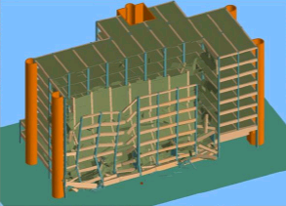
If you don’t follow design/ model then …

Slide 23
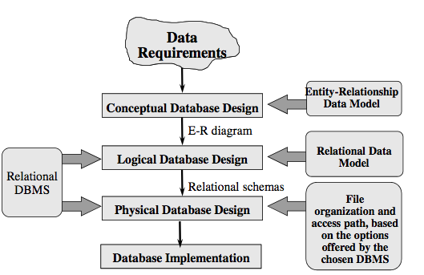
Design Process

Slide 24
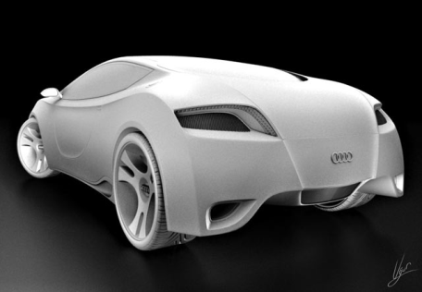
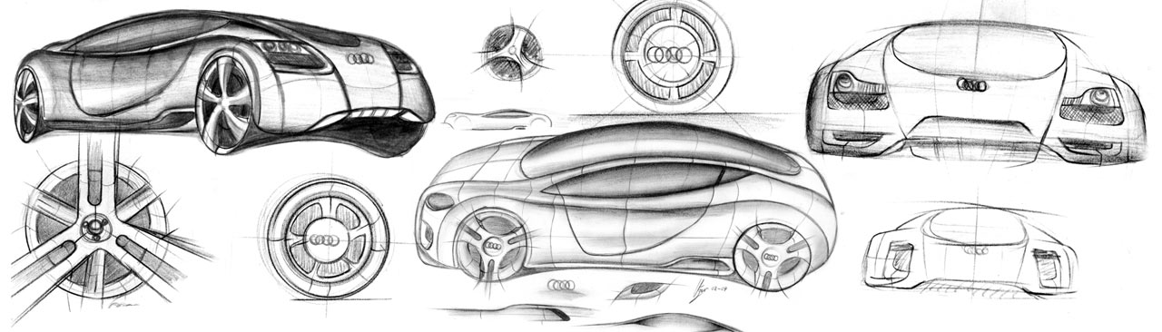
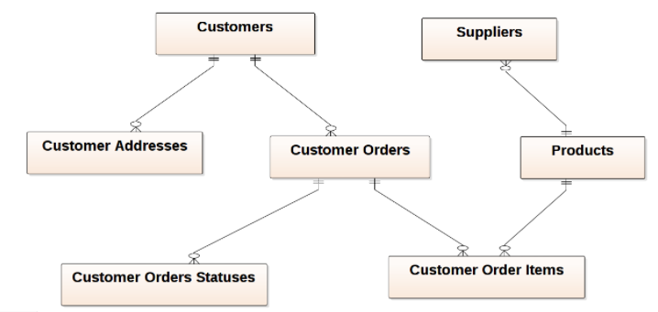
Conceptual Model
Model: an abstraction of a real-world object or event
Useful in understanding complexities of the real-world environment
Data model
A diagram that displays a set of tables and the relationships between them

Slide 25
What is an Entity Relationship Diagram (ERD)?
ER model is used to show the Conceptual schema of an organization.
ER model can express the overall logical structure of a database graphically.
ERD is a data modeling technique used in software engineering to produce a conceptual data model of an information system.
The model is later transformed into a Logical model (e.g. relational) on which the physical database is built

Slide 26
E-R Model
It was proposed by Peter Chen in 1971 to create a uniform convention which can be used for relational database.
E-R Model stands for Entity-Relationship Model, also known as E-R Diagram.
E-R Model is a high-level conceptual data model diagram.
E-R model helps us to systematically analyze data requirements to produce a well-designed database.

Slide 27
E-R Model…
The ER Model represents real-world entities and the relationships between them.
It is an easy to use graphical tool for modeling data.
Widely used in Database Design.
It is a GUI representation of the logical structure of a database.

Slide 28
Why use ER Diagrams?
Helps to describe entities, attributes, relationships.
Provide a preview of how all your tables should connect, what fields are going to be on each table.
ER diagrams are translatable into relational tables which allows you to build databases quickly.
ER diagrams can be used by database designers as a blueprint for implementing database.
The database designer gains a better understanding about the database with the help of ER diagram.

Slide 29
Advantages
Simple: If we know the relationship between the attributes and the entities we can easily build the ER Diagram for the model.
Effective Communication Tool: This model is used widely by the database designers for communicating their ideas.
Easy Conversion to any Model: This model can be converted to any other model like relational, network, hierarchical model etc.

Slide 30
Disadvantages
No industry standard for notation: means one developer might use notations which are not understood by other developers.
Hidden information: As it is a high-level view so there are chances that some details of information might be hidden.

Slide 31
SUMMARY OF ER-DIAGRAM NOTATION
Symbol
Meaning
ENTITY TYPE
WEAK ENTITY TYPE
RELATIONSHIP TYPE
IDENTIFYING RELATIONSHIP TYPE
ATTRIBUTE
KEY ATTRIBUTE
MULTIVALUED ATTRIBUTE
COMPOSITE ATTRIBUTE
DERIVED ATTRIBUTE
E₁
R
E₂
TOTAL PARTICIPATION OF E2 IN R
E₁
R
N
E₂
CARDINALITY RATIO 1:N FOR E1:E2 IN R
R
(min,max)
E
STRUCTURAL CONSTRAINT (min, max) ON PARTICIPATION OF E IN R

Slide 32
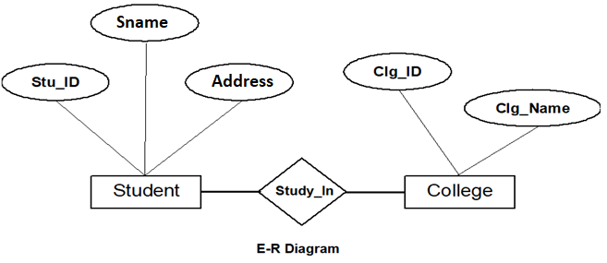
Components of the ER Diagram
This model is based on three basic concepts:
Entities.
Attributes.
Relationships.
Example

Slide 33

What is an Entity?
An entity is a real-world thing which is distinguishable from other.
An entity can be place, person, object, event or a concept.
Every entity is made up of some 'attributes' which represent that entity.
It is represented by a rectangle.
Examples:
Person: Employee, Student, Patient.
Place: Store, Building.
Object: Machine, product, and Car.
Event: Sale, Registration, Renewal.
Concept: Account, Course.

Slide 34
Guidelines for naming and defining entity types
An entity type name is a singular noun
An entity type should be descriptive and specific
An entity name should be concise
Event entity types should be named for the result of the event, not the activity or process of the event.

Slide 35
Types of Entities
Strong Entity
Strong entity is an entity which has a key attribute.
The primary key helps in identifying each entity uniquely.
e.g., Faysal Bank is uniquely identified by its bank number.
Weak Entity
A weak entity cannot be uniquely identified by its own attributes.
Weak entity types have partial keys.
Partial Keys are set of attributes with the help of which the tuples of the weak entities can be distinguished and identified.
They are represented with double rectangles.

Slide 36
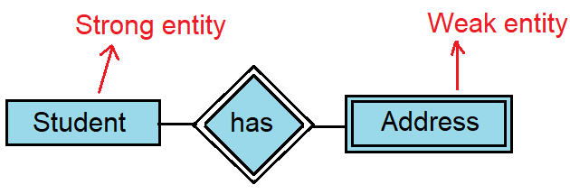
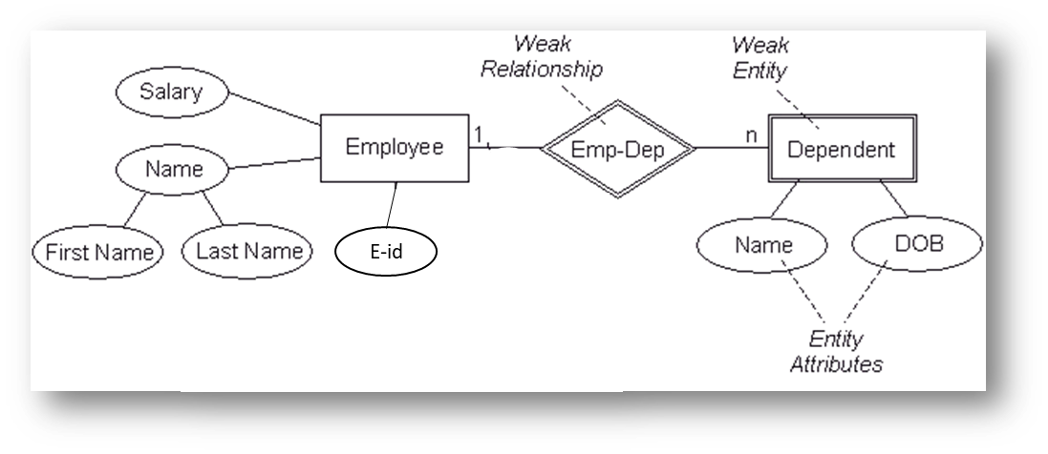
No Unique key
Partial Key/Discriminator

Slide 37
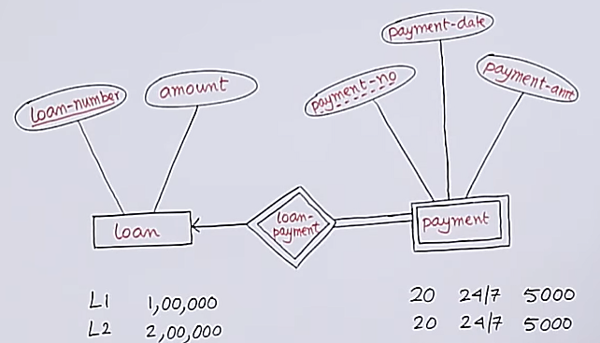
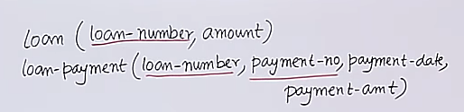
Partial Key
Weak Entity
Identifying Relationship

Slide 38
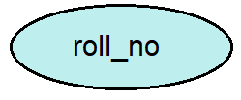
What is an attribute?
An attribute is a property or characteristic of the entity that holds it.
For example, a student might have attributes: roll_no, name, address, phone_no, etc.
It is represented by an ellipse/oval.
There exist a specific domain or set of values for each attribute from where the attribute can take its values.
For example, a student's name cannot be a numeric value. It has to be alphabetic. A student's age cannot be negative, etc.

Slide 39
Guidelines for naming attributes
An attribute name is a noun.
An attribute name should be unique
To make an attribute name unique and clear, each attribute name should follow a standard format
Similar attributes of different entity types should use similar but distinguishing names.

Slide 40
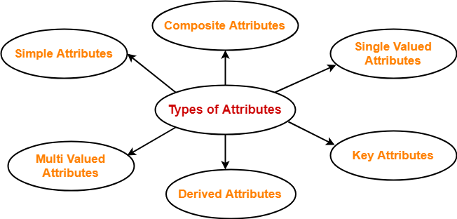
Types of attributes
In ER diagram, attributes associated with an entity set may be of the following types-
Simple attribute.
Composite attribute.
Single valued attribute.
Multi valued attribute.
Derived attribute.
Key attribute.

Slide 41
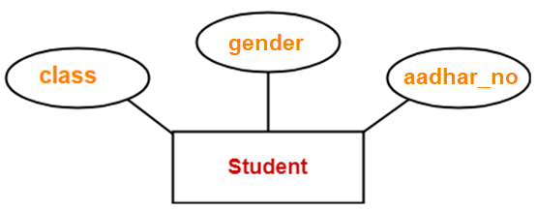
Simple attribute
Simple attributes are atomic values, which cannot be divided further.
Example:
CNIC
Here, student’s class, gender, dob are atomic values which can not be divided further.

Slide 42
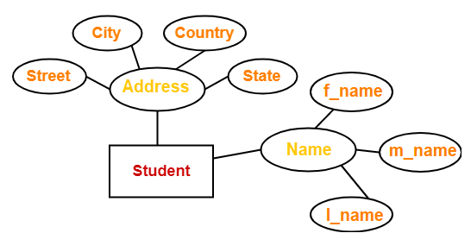
2. Composite attribute
A composite attribute is made up of more than one simple attribute.
A composite attribute can be further divisible.
Example:
Here, the attributes “Name” and “Address” are composite attributes as they are composed of many other simple attributes.

Slide 43
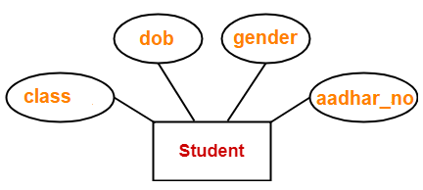
3. Single Valued Attribute:
These are the attributes which can take only one value at a time.
Example:
Here, all the attributes are single valued attributes as they can take only one at a time.

Slide 44
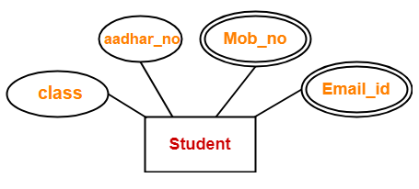
4. Multi-Valued Attribute
These are the attributes which can take more than one value at a time.
It is represented by a double ellipse.
Example:
Here, the attributes “Mob_no” and “Email_id” are multi-valued attributes as they can take more than one value.

Slide 45
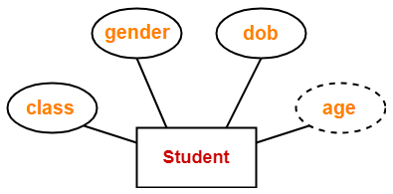
5. Derived Attribute
These are the attributes which can be derived from other attribute(s).
It is represented by dashed ellipse.
Example:
Here, “age” is a derived attribute as it can be derived from the attribute “dob”.
Notes:
NumberofEmployees

Slide 46
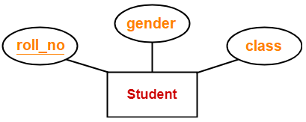
6. Key Attribute
These are the attributes which can identify an entity uniquely in an entity set.
Key attributes should be underlined.
Example:
Here, the attribute “roll_no” is a key attribute as it can identify each student uniquely.

Slide 47
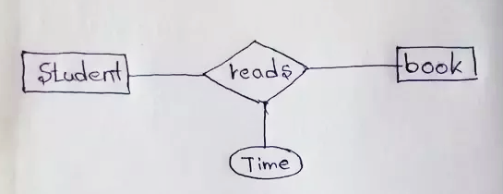
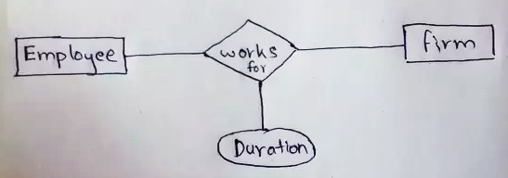
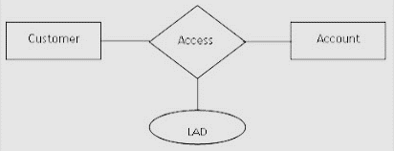
7. Descriptive Attribute
The descriptive attribute describes a relationship. It gives additional information about the relationship.
Example:
Notes:
A customer accesses his/her account to withdraw or transfer funds. And, we would like to store the information LAD (Last Accessed Date)

Slide 48
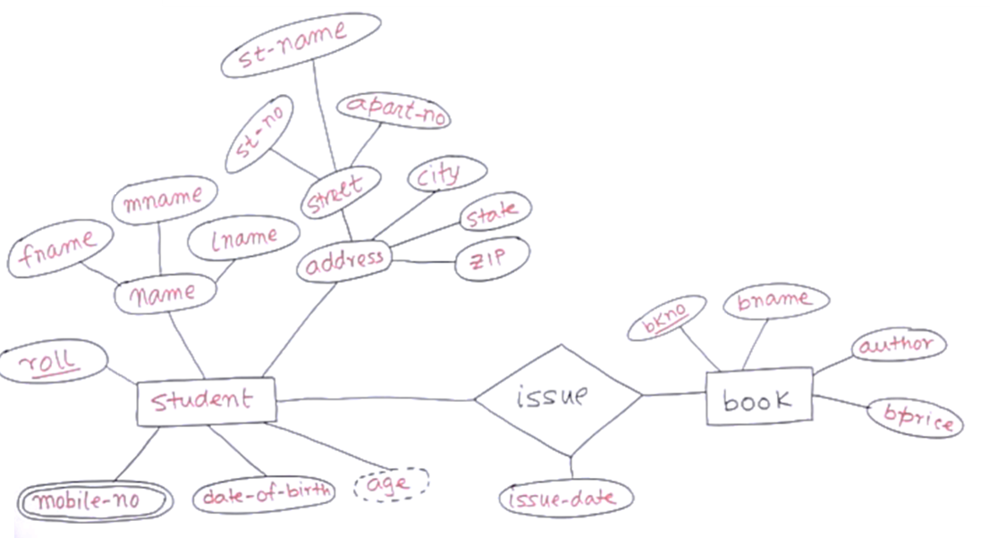
Practice Question
Composite Attribute
Key Attribute
Relationship
Entity
Entity
Derived Attributes
Descriptive Attributes
Multi-valued Attributes

Slide 49
Case Study
A university registrar’s office maintains data about the following entities:
courses, including number, title, credits, syllabus, and prerequisites;
course offerings, including course number, year, semester, section number, instructor(s), timings, and classroom;
students, including student-id, name, and program; and
instructors, including identification number, name, department, and title. Further, the enrollment of students in courses and grades awarded to students in each course they are enrolled for must be appropriately modeled.
Construct an E-R diagram for the registrar’s office. Document all assumptions that you make about the mapping constraints.

Slide 50
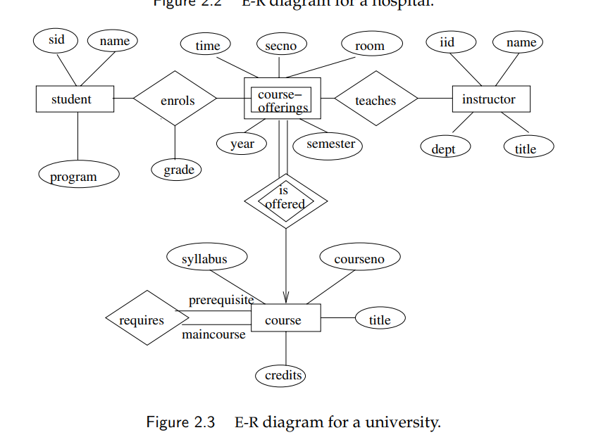

Slide 51

Any Questions?

